Slide 1
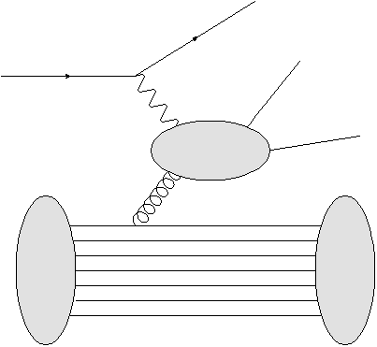
A hybrid model
Parton level interaction , parton shower and jet fragmentation completed in PYTHIA.
Energy loss effect from extended BDMPS for cold nuclear medium
e⁻
e⁻
σ
A
A’
Nuclear geometry by DPMJET plus nuclear PDF provided in EPS09.
Nuclear evaporation ( gamma dexcitation/nuclear fission/fermi break up ) treated by DPMJet

